Slide 1
Stress and Coping Strategies

Slide 2
Syllabus
Concepts of Stress
Stages of Stress
Model of Stress
Causes and Symptoms of Stress
Strategies of Stress Management

Slide 3
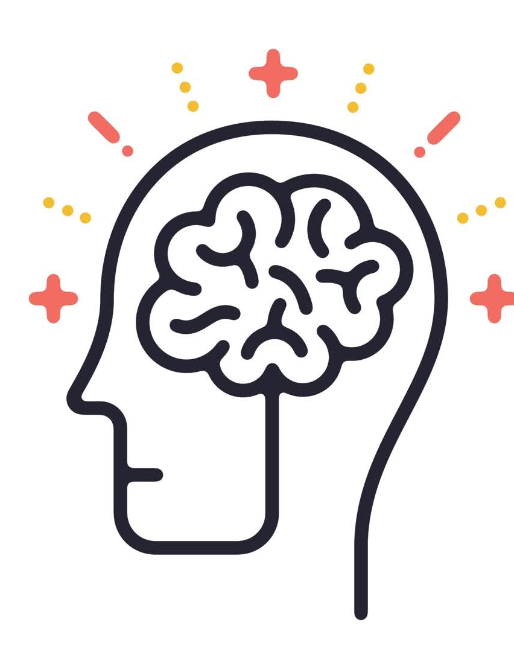
What is Stress
According to WHO:
Stress can be defined as a state of worry or mental tension caused by a difficult situation. Stress is a natural human response that prompts us to address challenges and threats in our lives.
Everyone experiences stress to some degree. The way we respond to stress, however, makes a big difference to our overall well-being.

Slide 4
American Psychology Association defines
Stress is a normal reaction to everyday pressures, but can become unhealthy when it upsets your day-to-day functioning. Stress involves changes affecting nearly every system of the body, influencing how people feel and behave.
By causing mind–body changes, stress contributes directly to psychological and physiological disorder and disease and affects mental and physical health, reducing quality of life.
Adapted from the APA Dictionary of Psychology

Slide 5
Types of Stress
The two main types of stress are acute and chronic:
Acute stress
Short-term stress that can be positive or negative. It can occur when you do something new or exciting, or when you face upcoming challenges. Acute stress often goes away quickly once the challenge is resolved.
Chronic stress
Long-term stress that can last for weeks or months. It can occur due to money problems, an unhappy marriage, or trouble at work. Chronic stress can lead to health issues if left unmanaged
Source: WHO

Slide 6
Positive and Negative
Positive stress that motivates, improves performance.
Example: Preparing for a big event, Preparing Board Exam, Competitive exam, meeting a challenge.
Negative stress that leads to anxiety, poor health outcomes.
Example: Financial problems, job pressures.
Source: "The Stress of Life" by Hans Selye.

Slide 7
Causes of Stress – General
Pressure at workplace: Deadlines, workload, lack of control
Life Changes: Major events (death, divorce, financial issues)
Relationship Issues: Conflict, breakups, loneliness
Health Problems: Chronic illness, mental health concerns
Environmental Factors: Noise, pollution, unstable conditions
Financial Factors: Loss of income etc..

Slide 8
Symptoms of Stress
Physical: Headaches, muscle tension, fatigue, insomnia
Emotional: Anxiety, irritability, mood swings, sadness
Cognitive: Poor concentration, forgetfulness, constant worrying
Behavioral: Procrastination, overeating/undereating, social withdrawal

Slide 9
Top 3 most widely used models of stress
1. Transactional Model of Stress and Coping (Lazarus & Folkman, 1984)
This model is a comprehensive frameworks for understanding stress, emphasizing the role of individual appraisals (how we assess stressors) and coping strategies.
It is widely applied in both clinical and everyday stress management contexts.
Key Application: Commonly used in psychological research, therapy sessions: especially cognitive-behavioral approaches, and health psychology to understand how people deal with stress.

Slide 10
General Adaptation Syndrome (GAS) (Hans Selye, 1956)
This biological model was one of the earliest comprehensive descriptions of the body's physiological response to stress. It introduced key concepts such as the alarm, resistance, and exhaustion stages, which are foundational to understanding the physical impact of stress.
Key Application: Frequently referenced in health psychology, medicine, and research on chronic stress and its effects on the body.

Slide 11
Diathesis-Stress Model
This model is widely used in psychology and psychiatry to explain how mental health disorders develop due to the interaction between predisposed vulnerabilities and stressful life events. It provides a framework for understanding the onset of conditions like depression, anxiety, and schizophrenia.
Key Application: Extensively used in clinical psychology and psychopathology to study mental illness and stress-induced disorders

Slide 12
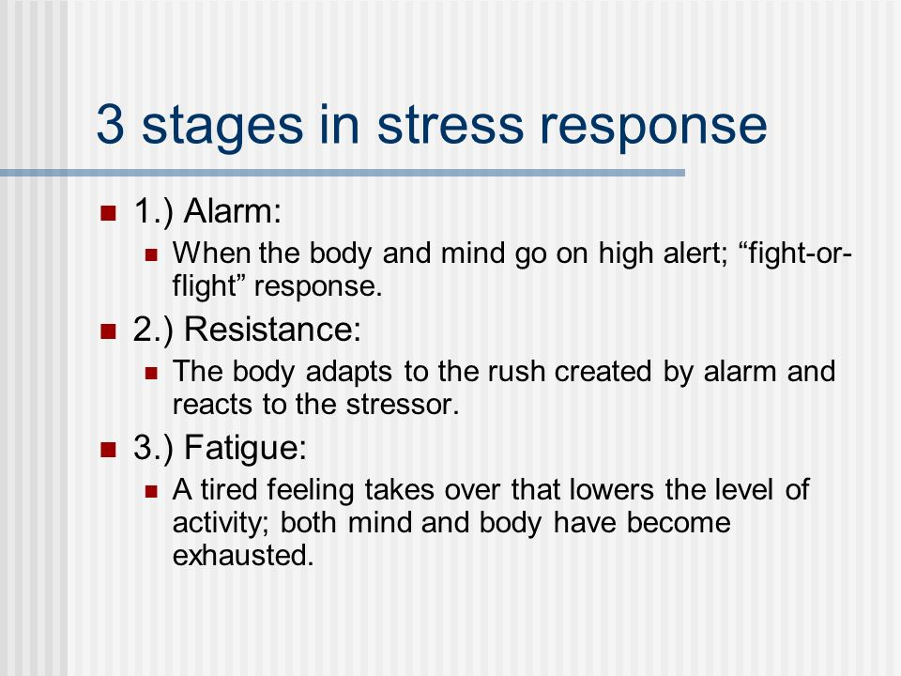
Three Stages in stress

Slide 13
Stress management technique
Take time to relax: Try deep breathing, meditation, yoga, tai chi, or prayer. Art based – Drawing, Playing an instrument, listening to music, dancing etc..
Exercise: Working out, playing a sport, or dancing can help manage stress and improve your mood.
Eat healthy: Healthy and Nutritious Food.
Get enough sleep: Most adults need 7 to 8 hours of sleep each night.
Spend time in nature: Being in nature can help reduce stress.
Practice mindfulness: Mindfulness can help you manage stress.
Take time for yourself: Do things you enjoy, like reading, playing with pets, or working in the garden.
Talk to friends and family: Talking to loved ones can help you manage stress.
Change your situation or reaction: Try to take control of your situation.
Reduce screen time: Try to spend less time in front of a screen and more time relaxing.
Avoid alcohol and drugs: Don't use alcohol or drugs to manage stress

